Slide 1


AUTONOMOUS
COGNITIVE
AGENT
-by Pavani Sai

Slide 2


Project Overview
This project implements an Autonomous Cognitive Agent System capable of reasoning, planning, and acting independently. Instead of relying on a single prompt-response interaction, the system maintains context, uses tools, and executes tasks over long horizons.
Build an autonomous AI agent system
Key features: reasoning, tool usage, persistent memory
Modular, scalable, multi-agent design
This system demonstrates how LLMs can be transformed from simple chat models into stateful, goal-driven autonomous agents.

Slide 3
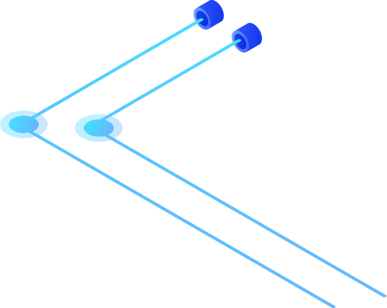
Core Technologies Used
The system is built using modern AI orchestration frameworks and high-performance LLMs.
Stack Overview:
Python – Core implementation language
LangChain – LLM integration, prompts, and tools
LangGraph – Stateful, graph-based execution
Groq-hosted LLMs – Fast inference for reasoning
Virtual File System (VFS) – Persistent memory layer
This stack ensures performance, modularity, and maintainability.

Slide 4
System Architecture
The system follows a Supervisor–Worker multi-agent architecture.
A central Supervisor Agent coordinates multiple specialized agents, while all agents share a persistent memory system.
Architectural Principles:
Separation of reasoning and execution
Clear role-based agent responsibilities
Shared persistent state
This design improves scalability, clarity, and fault isolation.

Slide 5

Supervisor Agent
The Supervisor Agent acts as the brain of the system. It interprets user intent, creates execution plans, and coordinates all other agents.
Key Responsibilities:
Understand user intent
Convert queries into structured plans
Delegate tasks to specialized agents
Integrate memory and agent outputs
Produce the final response
This controlled planning ensures deterministic and explainable execution.

Slide 6
Worker Agents and Their Roles
To reduce complexity, responsibilities are distributed among specialized agents.
Agents in the System:
Search Agent – Retrieves information from internal or external sources
Summarizer Agent – Condenses large outputs into concise summaries
Each agent focuses on a single responsibility, improving reliability and clarity.

Slide 7
Persistent Memory (VFS)
The system uses a Virtual File System (VFS) to overcome LLM context limitations.
Memory Capabilities:
Stores conversation history and decisions
Supports read, write, update, and list operations
Persists across sessions
This enables long-term reasoning and context-aware responses.

Slide 8
Tools Layer
Agents do not directly execute actions. Instead, they use tools like web_search and summarize_text.These are the tools I used in this project.
Why Tools Matter:
Improves system safety
Keeps agent logic clean
Enables easy extension
The agent decides what to do, while tools handle how it is done.

Slide 9
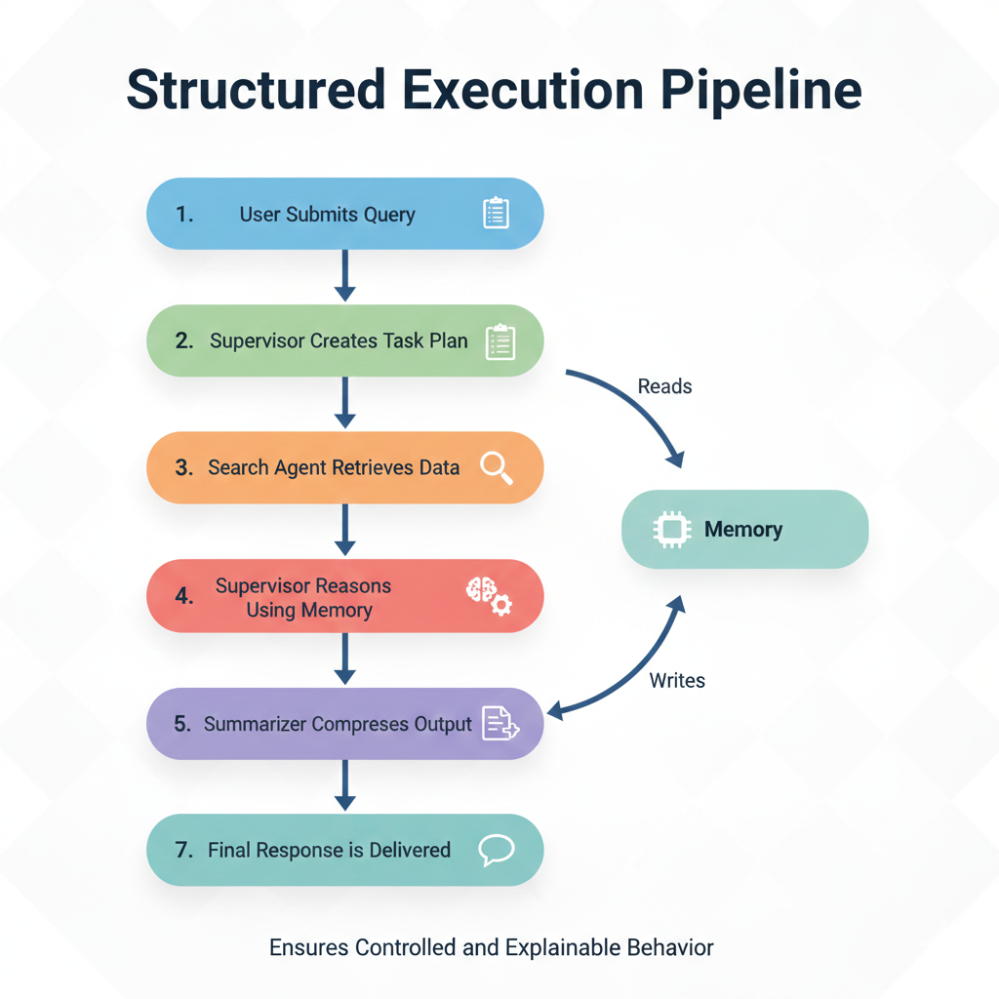

End-to-End Workflow
The system follows a structured execution pipeline:
User submits a query to the system.
Supervisor Agent interprets the request and
creates a structured task plan.
3.Search Agent retrieves relevant information as
required using the web_search tool.
4.Supervisor performs reasoning using retrieved
data and persistent memory.
5.Summarizer Agent compresses the generated
output using the summarize_text tool.
6.System updates memory with latest interaction.
7.Final, refined response is delivered to the user.

Slide 10
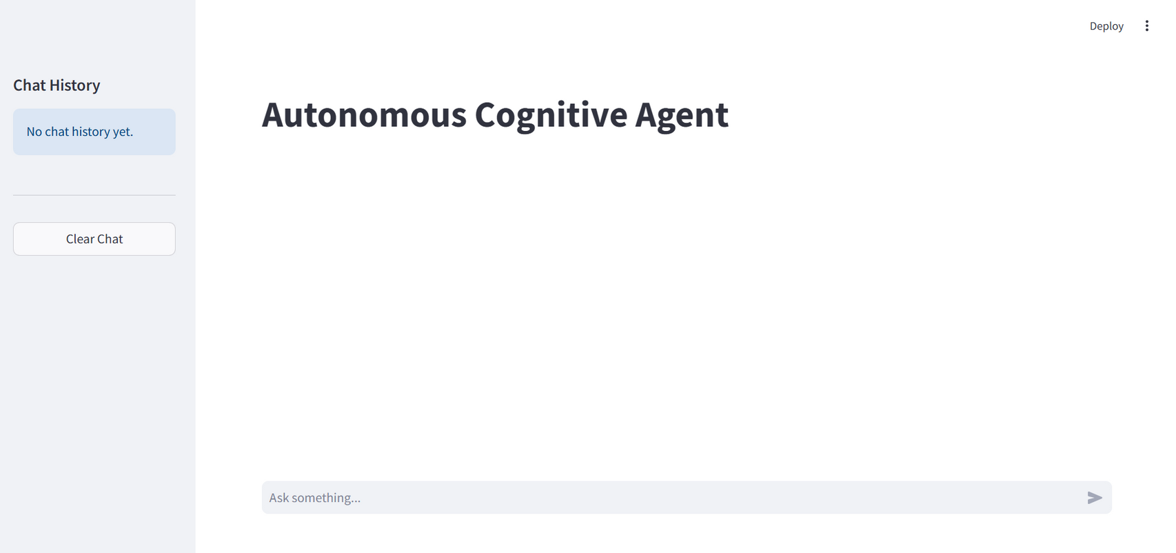
User Interface

Slide 11
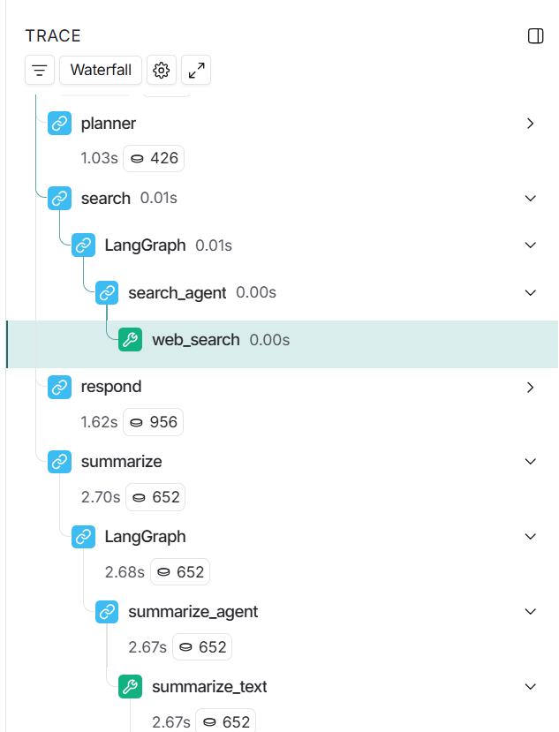
LangSmith Trace
The system uses LangSmith tracing to visualize and monitor the complete agent execution flow.
Trace Highlights:
Supervisor planning and agent delegation
Tool usage and memory access
Step-by-step reasoning path
Benefits:
Improves explainability
Enables debugging and optimization

Slide 12
Challenges & Solutions
Key Problems and How They Were Solved
Challenges Faced:
Limited LLM context
Inconsistent outputs
Complex multi-agent coordination
Solutions Implemented:
Persistent VFS memory
Planning-based execution (TODO phase)
Supervisor–Worker architecture
LangGraph for state management

Slide 13
Future Scope
The system can be extended to support more advanced autonomy and intelligence through the following enhancements:
Specialized Agents – Introduce domain-focused agents to improve task efficiency and scalability
External Integrations – Connect APIs and databases for real-time data access and persistent knowledge
Enhanced Memory Reasoning – Improve long-term memory handling with prioritization and semantic recall
Autonomous Task Loops – Enable continuous plan–execute–evaluate cycles with minimal human input

Slide 14
Conclusion
This project demonstrates a production-ready autonomous cognitive architecture that combines:
Planning and reasoning
Multi-agent coordination
Persistent memory
Tool-driven execution
The system provides a strong foundation for autonomous research systems, intelligent assistants, and long-horizon AI applications.

Slide 15
THANK YOU
Questions & Discussion
-

